Slide 1

Amb. (r.) David Huebner
March 13, 2019

Slide 2
Entertainment & Media Sector
Film
Television
Radio
Music
Print / Publishing
Theater
Advertising
Video Games
E-Sports
Internet
MMOs
Platform Media
Podcasts
Digital Media
OTT Video
Etc.
? ≠

Slide 3
Magnitude
2018, U.S. market: US$ 700 billion
2018, global market: US$ 2.2 trillion
Compare …
  Global oil & gas industry: US$ 2 trillion
  Global pharma industry: US$ 950 billion
  Global aviation industry: US$ 805 billion
  Global snack food industry: US$ 525 billion
2020, est. global market: US$ 2.5 trillion
(statistics synthesized from PwC, Statista, & other sector market reports)

Slide 4
Growth Areas
Top sectors
  Virtual reality: + 41% CAGR
  E-sports: + 21% CAGR
  OTT video: + 10% CAGR
Top markets
  Nigeria: + 21% CAGR
  Egypt: + 18% CAGR
  Indonesia: + 10% CAGR
(projections drawn from PwC & USG market reports)

Slide 5
Wildcards
Enhanced Reality
  computer alters your perception of the real world
    “computer-mediated” reality
    overlays, masks/cloaks, add-ins, other alterations
  integrative, immersive, & “real”
  visual, auditory, olfactory, haptic, somatosensory
Artificial Intelligence
  assistant
  curator
  creator
  collaborator

Slide 6
Ecosystem Drivers
Ubiquitous connectivity
Darwinian revenue diversification
  Ex.: teleco move into entertainment
Value shift to platform media
  Ex.: Facebook as one-stop kraken
Personalization imperative
  Driven by demographic changes
  Facilitated & fueled by data analytics, antiquated regulatory frameworks, & AI applications
Participation imperative

Slide 7
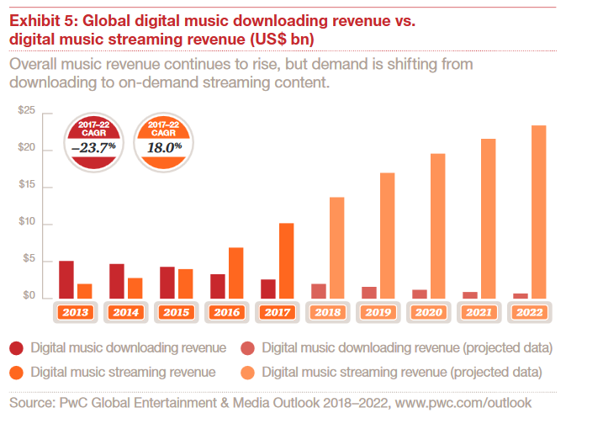
Hyper Evolution

Slide 8
Subject Matter
Joint ventures / co-production deals
Financing / restructuring
Intellectual property R&D, licensing, sale, & infringement
Distribution / exhibition / VOD / streaming
Talent contracts
Royalty agreements
Fee & rate setting
Privacy & publicity
Certain torts
Expropriation / compliance / investor-state
Etc.

Slide 9
Rules
IFTA International Rules
  Independent Film & Television Alliance (formerly AFMA)
UNCITRAL
JAMS
ICC
ICDR
CIETAC
SHIAC
LCIA
WIPO
Etc.

Slide 10
Practice
There are few purely “domestic” deals
There are fewer purely “domestic” disputes
Each sector has its own deal structures and templates (if any), customs & practices, legal issues, legal frameworks, networks, uncertainties, recurring disputes, & IP
Important to stay up-to-date and connected
Reward: many of the sectors are not yet over- populated with skilled lawyers & neutrals
Risk: look for authentic expertise when choosing neutrals / counsel; titles & lists ≠

Slide 11
U.S. motion picture studio v. Chinese tech company, re VOD joint venture collapse
Chinese entity v. U.S. entity, re dissolution of AI/VR-related entertainment finance fund
East Asian teleco v. East Asian patent troll fund, re licensing/infringement of suites of optic & haptic patents
French motion picture studio v. Egyptian entity, re copyright dispute over film subject matter
London-based producer v. U.S. investor, re unsuccessful co-production of a musical version of an iconic movie drama
Rate setting dispute between global music content holder and large music broadcaster
OTT video platform v. large content producer, re access & licensing dispute
Large teleco v. large app developer, re disputes over ownership, valuation, & sale of portfolio of app assets including patents

Slide 12
Contact
      Amb. (r.) David Huebner
      JAMS
      c/o Case Mgr. Anne Lieu
      +1-213-620-1133
      DH@HuebnerArbitration.com
      www.HuebnerArbitration.com

